Slide 1


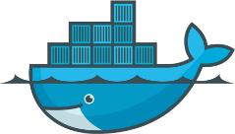
Kubernetes 部署架构图
Salve Node
Kubelet
Kuber Proxy
Docker Daemon
Master Node
Kubelet
Kuber Proxy
Docker Daemon
Salve Node
Kubelet
Kuber Proxy
Docker Daemon
Scheduler
Controller Manager
API Server
Etcd
Salve Node
Kubelet
Kuber Proxy
Docker Daemon

Slide 2
Master Node1
Kubelet
Kuber Proxy
Docker Daemon
Master Node1
Scheduler
Controller Manager
Kubelet
Kuber Proxy
Docker Daemon
API Server
Scheduler
Controller Manager
Etcd
API Server
Etcd

